Slide 1
CAASPP Online Student Testing
2016
Notes:
1

Slide 2
Student Participation: General
The Smarter Balanced Summative Assessments consist of the following:
English Language Arts/Literacy (ELA)
Computer Adaptive Test (CAT)
Classroom Activity
Performance Task (PT)
Mathematics
Computer Adaptive Test (CAT)
Classroom Activity
Performance Task (PT)

Slide 3
Student Participation: General
All students in grades 3–8 and grade 11 take the Smarter Balanced Summative Assessments with the following exceptions:
Students enrolled in or assigned to grades 3–8 and grade 11 whose IEP team designates the use of the California Alternate Assessments (CAAs) for ELA and mathematics
English learners who have been enrolled in a school in the United States less than 12 months (ELA only)

Slide 4
Student Participation: Early Assessment Program
11th GRADE ONLY
The Early Assessment Program (EAP) uses the high school Smarter Balanced Summative Assessments for ELA and mathematics.
Students taking the Smarter Balanced Summative Assessments in high school may choose to release their test scores to the California State University (CSU) and participating California Community Colleges (CCC) at the end of the computer adaptive tests.
Students who do not authorize the release of their test scores to CSU and CCC at the time of testing may need to provide a copy of the CAASPP score report to the campus, upon request.

Slide 5
Smarter Balanced Summative Assessments
Computer adaptive test (CAT):
Students complete the CAT portion of the assessment for both ELA and mathematics.
The CAT includes a wide variety of question types.
As a student progresses, the difficulty of questions is adjusted on the basis of the student’s responses.
A student who answers a question correctly will receive a more challenging question
An incorrect answer will generate an easier question

Slide 6
Smarter Balanced Summative Assessments
Performance Task:
Students complete a performance task for both ELA and mathematics.
The Performance Task is designed to provide students with an opportunity to demonstrate their ability to apply their knowledge and higher-order thinking skills to explore and analyze a complex, real-world scenario.

Slide 7
Testing Time
Estimated testing times:
Content Area | Grades | Computer Adaptive Test (CAT) questions hrs : mins | Performance Task (PT) hrs : mins | Total hrs : mins | Classroom Activity (administered prior to the PT)* hrs : mins | Total hrs : mins
English Language Arts/Literacy | 3–5 | 1:30 | 2:00 | 3:30 | :30 | 4:00
 | 6–8 | 1:30 | 2:00 | 3:30 | :30 | 4:00
 | 11 | 2:00 | 2:00 | 4:00 | :30 | 4:30
Mathematics | 3–5 | 1:30 | 1:00 | 2:30 | :30 | 3:00
 | 6–8 | 2:00 | 1:00 | 3:00 | :30 | 3:30
 | 11 | 2:00 | 1:30 | 3:30 | :30 | 4:00
Both | 3–5 | 3:00 | 3:00 | 6:00 | 1:00 | 7:00
 | 6–8 | 3:30 | 3:00 | 6:30 | 1:00 | 7:30
 | 11 | 4:00 | 3:30 | 7:30 | 1:00 | 8:30

Slide 8
TEST SECURITY
Personal items other than student identification documents are not allowed in any testing room during administration of the California Assessment of Student Performance and Progress (CAASPP).
Students should not have access to their personal items, other than student identification, during the test or during breaks. This includes cell phones, smart phones, digital watches, smart watches, activity-monitoring devices, and any other electronic recording, listening, scanning or photographic device.

Slide 9
General Test Rules
Students must answer all test questions on a page (i.e., screen) before moving on to the next page.
Students may not return to a test segment once it has been completed and submitted.
Students must answer all test questions before the test can be submitted.
Students may not return to a test once it has been completed and submitted.

Slide 10
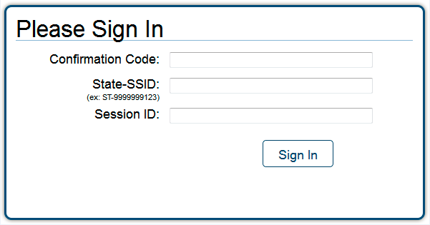
Taking the Test
Students log on through the secure browser.
To log on, students need:
First Name (Confirmation Code): Student’s legal first name as spelled in CALPADS
State-SSID: “CA” followed by a hyphen “-” and the student’s SSID
Session ID: Test administrator -generated Session ID

Slide 11
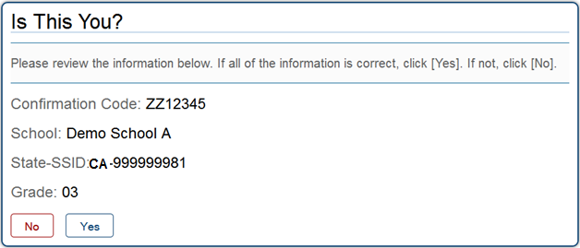
Test Session
Students verify their identity.
After logging on, students will see the “Is This You?” screen.
Students should select Yes to continue if the information on the screen is correct.

Slide 12
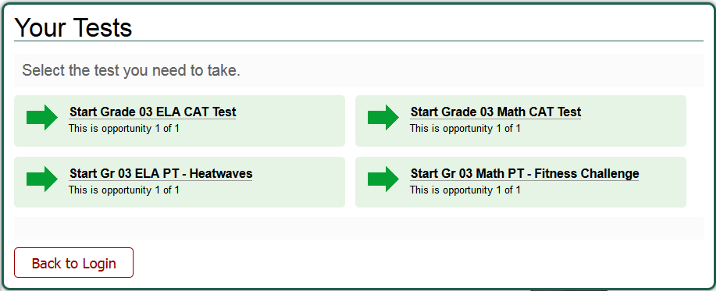
Test Session
Student selects the test.
All grade-level tests that the student is eligible to take are displayed.
Only the tests that the test administrator has selected for the test session and those that have not been completed are selectable by students.

Slide 13
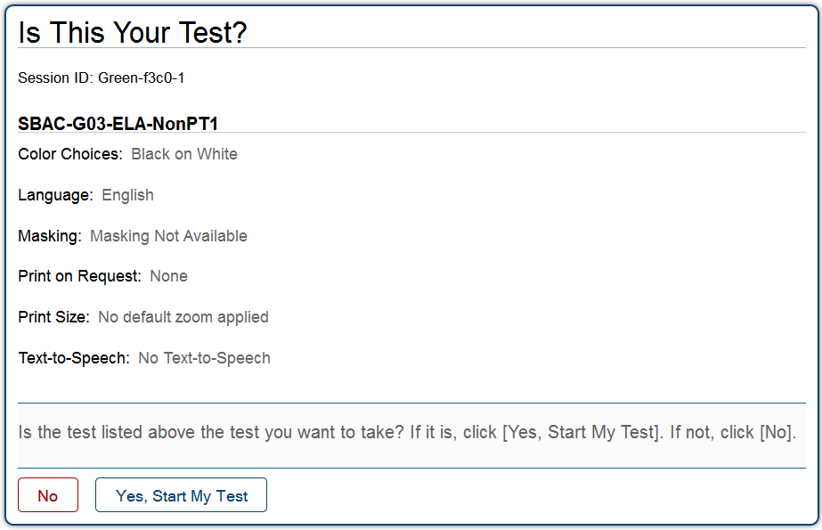
Test Session
After the test administrator has approved a student for testing, the student verifies the test information and settings.
The student will select
Yes, Start My Test to begin testing or No if the settings are incorrect.

Slide 14
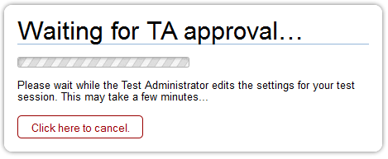
Test Session
Upon selecting a test, students wait for test administrator approval.

Slide 15
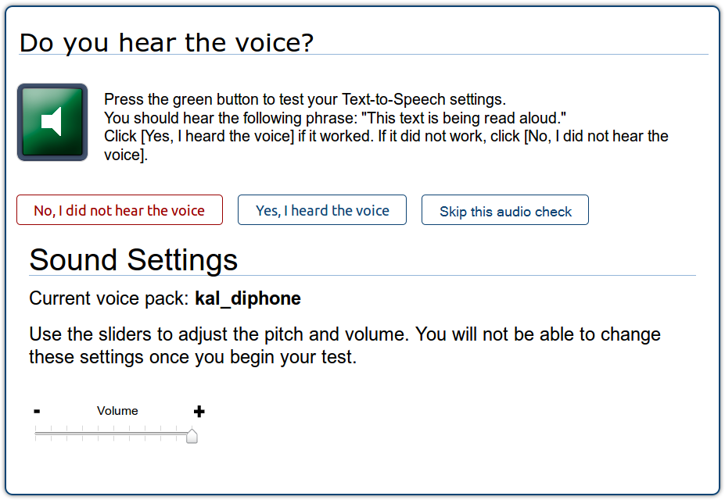
Sound Check
If a student has a text-to-speech accommodation or is taking a test with ELA listening questions, he or she will verify the audio checks through headphones.
Test with listening questions audio check
Text-to-speech audio check

Slide 16
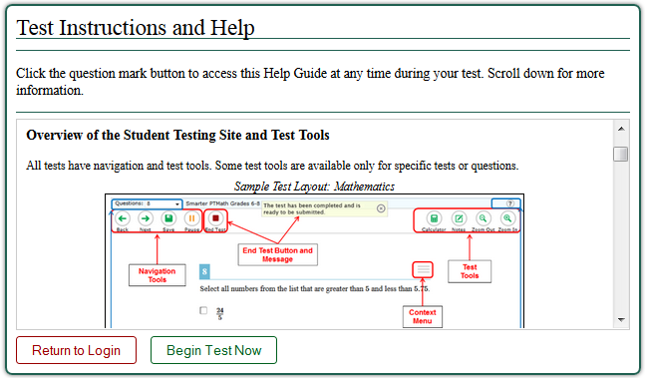
Beginning Test
Finally, students will see the Test Instructions and Help page before they begin testing. Students will select Begin Test Now to begin testing.

Slide 17
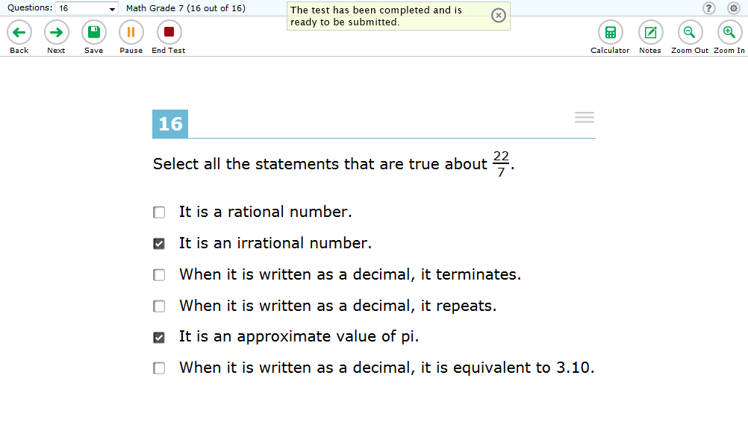
Reaching the End of the Test
After students answer the last question on the test, the End Test button will appear in the upper-left corner of the screen.

Slide 18
Reaching the End of the Test
Upon selecting the End Test button, an “Attention” message will appear.
Students will select [Yes] to proceed with reviewing answers and submitting the test.

Slide 19
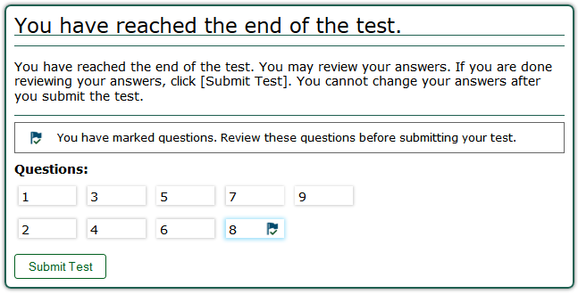
Reaching the End of the Test
Students may review answers before submitting a test.

Slide 20
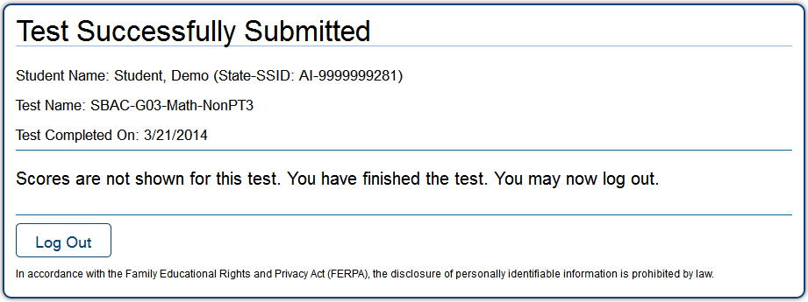
Reaching the End of the Test
When a student is ready to submit the test, he or she will receive a confirmation screen.

Slide 21
Questions

