Slide 1
Sacramento City Unified School District
Audit Results for the year ended
June 30, 2022
December 15, 2022

Slide 2
Background on Crowe LLP
Crowe LLP is an international accounting and advisory firm
Currently the 11th largest accounting firm in the United States
Crowe LLP has served California K-12 school districts for over 30 years:
Currently audit:
3 of the 5 largest districts in California
7 of the 20 largest districts in California
Crowe LLP is independent of Sacramento City Unified School District

Slide 3
Auditor’s Responsibilities, Planned Scope, and Audit Timeline
Express an opinion on the financial statements, federal and state compliance
Risk of material misstatement
Internal control evaluation
Risk based audit approach
Phase One – May/June 2022
Phase Two – October 2022
Reporting / Completion –
November/December 2022

Slide 4
Other Required Communications
There were no difficulties encountered with management
There were no disagreements with management
No consultation with other accountants
No significant or adverse events require your attention in connection with the completion of the audit

Slide 5
Audit Results
Type of Opinion | Results / Questioned Cost
Financial Statements | Unmodified
Deficiency – Segregation of Duties in Journal Entry Processing
Federal Compliance | Unmodified
State Compliance | Qualified
Instructional Time Immunizations Charter School Attendance Charter School Annual Instructional Minutes | Fiscal impact: $46,174,423 Fiscal impact: $6,263 Fiscal impact: $314,621 Fiscal impact: $463,970 Total impact: $46,959,277

Slide 6
Audit Findings & Recommendations
Internal Control – Segregation of Duties in Journal Entry Processing
The District will implement stronger internal controls using the financial system
State Compliance – Immunizations
One student did not receive second immunization, fiscal impact $6,263
Additional controls implemented to follow-up with school sites
State Compliance – Charter School Attendance Reporting
Nonclassroom-based charter was incorrectly reported as classroom-based
No fiscal impact, District will submit revised state reports

Slide 7
Audit Findings & Recommendations
State Compliance - Shortage of Instructional Days and Minutes Offered
8 day workforce strike March 23 – April 1, 2022
District fiscal impact is $46,174,423
Charter fiscal impact is $778,591
District Accrued Liability
Waiver to make up the lost days by adding to the instructional calendar double the lost number of instructional days/minutes for two consecutive school years
Waiver contingent upon California Department of Education approval and negotiations

Slide 8
Conclusion
The District’s financial statements are presented fairly in all material respects
No federal compliance findings
Management and staff at the District office and other departments were prepared for our audit and responded timely to our requests
The District’s audit report was filed with the State Controller’s Office before the December 15, 2022 reporting deadline
“Crowe” is the brand name under which the member firms of Crowe Global operate and provide professional services, and those firms together form the Crowe Global network of independent audit, tax, and consulting firms. Crowe may be used to refer to individual firms, to several such firms, or to all firms
within the Crowe Global network. The Crowe Horwath Global Risk Consulting entities, Crowe Healthcare Risk Consulting LLC, and our affiliate in Grand Cayman are subsidiaries of Crowe LLP. Crowe LLP is an Indiana limited liability partnership and the U.S member firm of Crowe Global. Services to clients are provided by the individual member firms of Crowe Global, but Crowe Global itself is a Swiss entity that does not provide services to clients. Each member firm is a separate legal entity responsible only for its own acts and omissions and not those of any other Crowe Global network firm or other party. Visit www.crowe.com/disclosure for more information about Crowe LLP, its subsidiaries, and Crowe Global.
The information in this document is not – and is not intended to be – audit, tax, accounting, advisory, risk, performance, consulting, business, financial, investment, legal, or other professional advice. Some firm services may not be available to attest clients. The information is general in nature, based on existing authorities, and is subject to change. The information is not a substitute for professional advice or services, and you should consult a qualified professional adviser before taking any action based on the information. Crowe is not responsible for any loss incurred by any person who relies on the information discussed in this document. © 2021 Crowe LLP.

Slide 9
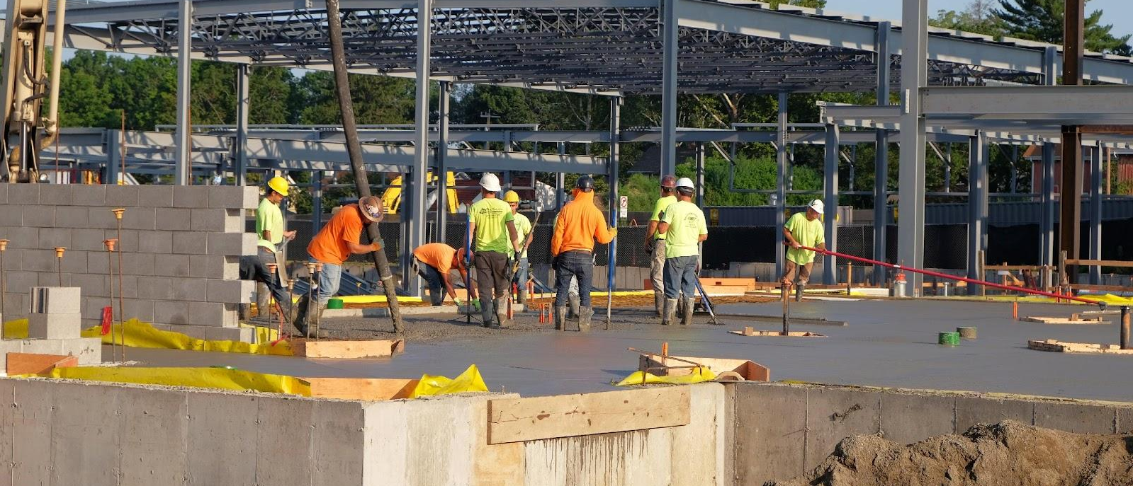
DEC | 15 | 2022
Approve Board Policy Board Policy
7310 Naming of Facilities

Slide 10
Acronyms
BP | Board Policy

Slide 11
Current Policy
BP 7310 was last updated in the late 1990’s.
Language currently does not call out a required alignment with the District’s vision and mission.
It only allows for the naming of facilities after individuals or geographic locations.
Outlines a vague need for community involvement without proper checks and balances.
Allows for the renaming of facilities only under “extraordinary circumstances.”

Slide 12
Proposed Policy Revisions
First reading was held on November 17, 2022.
Calls for the naming of facilities that reflect the District’s mission and vision.
Allows for the naming for facilities after individuals whose “primary legacy” aligns with the District’s mission and vision; geographic areas, landmarks, cultural events, or historic events; flora and fauna within our region; and other criteria such as an academic focus or other.
Refines language around the oversight of community engagement and the ability of the Board to rename facilities.
Notes:
Modeled after Riverside Unified policy

Slide 13
Impetus for Proposed Policy Revisions
The current renaming effort of Sutter, Kit Carson, and Peter Burnett have outlined areas of opportunity in current policy language.
The proposed policy revisions are important in the alignment of facilities naming moving forward.
Notes:
Alignment with District vision and mission
Provide more clarity around the implementation of the policy
Increase the possible areas of naming criteria

Slide 14
Next Steps
Approve the policy revisions.
Continue with the renaming efforts of Sutter, Kit Carson, and Peter Burnett.

Slide 15
Questions?
Notes:
Thank you.

Slide 16
Approve the Submission of a Credential Waiver Application to the California Commission on Teacher Credentialing
Board Meeting-December 15, 2022
Agenda Item No. 9.5
Presented by:
Cancy McArn, Chief Human Resources Officer, and
Tami Mora, Human Resources Audit & Compliance Analyst
Notes:
Good evening Board President, Board Members and Superintendent Aguilar. We are here this evening to present to you and ask for your approval of a credential waiver application.

Slide 17
Submission of a Credential Waiver Application to the California Commission on Teacher Credentialing
Education Code EC §44253.3 allows school districts to waive a portion of the requirement for a Certificated teacher in order to allow time for program completion
California Commission on Teacher Credentialing (CCTC) requires that every waiver request go through a public notice process at the local level and must be Board approved in a public meeting prior to the submission of the employing agency to CCTC
Notes:
Ed Code provides an opportunity for Districts to waive a portion of credential requirements in order to allow educators a little more time to complete their credential requirements.
In order to submit credential waiver applications for certificated employees in need, CTC (The Commission on Teacher Credentialing), requires a public notice process and board approval, prior to submission of any waiver applications.
That is why we are here this evening.

Slide 18
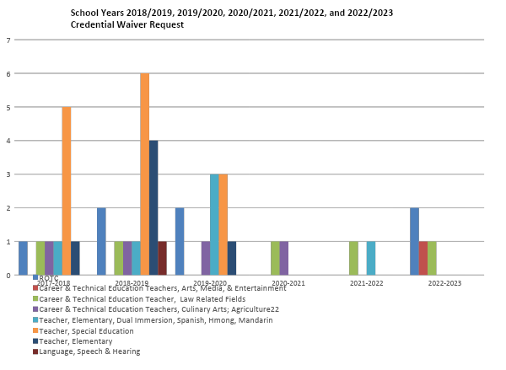
Notes:
Here are the data trends of credential waiver requests for our district over the last few years. We are continuously working with our employees to meet their credential requirements.

Slide 19
Submission of a Credential Waiver Application to the California Commission on Teacher Credentialing
A waiver is being requested for the following Career and Technical Education (CTE) teacher, as they complete their Clear Credential requirements, which will include English Language Authorizations (ELA):
Matthew Marsango, CTE credential in Arts, Media, and Entertainment (Albert Einstein Middle School)
Notes:
The applicant listed here is currently working on meeting their CTC requirements in order to obtain their English Language Authorization to provide instruction to English Learners.

Slide 20
Submission of a Credential Waiver Application to the California Commission on Teacher Credentialing
Specially Designed Academic Instruction Delivered in English (SDAIE) to English Learners (EL) is the area being requested in the waiver this evening.
This waiver will enable this teacher the opportunity to complete the requirements set forth by CTC and to remain in their positions while they continue their work with students.
Staff recommends approving this waiver request.
Notes:
The waiver requested this evening, will allow this teacher the additional time needed in order to complete their English Language Authorization, while they continue to work with our students.

Slide 21
Questions & Answers

