Slide 1
African American Advisory Board Kick-off Meeting
July 1, 2020
Zoom Meeting
Notes:
Iris and Vincent

Slide 2
AGENDA
Welcome and Thanks
Special Presentation from the superintendent of the Sacramento City Unified School District (Re-opening of Schools)
Purpose, Roles and Responsibilities
Revisit Norms
Frame context of recommendations
Review recommendations and ensure understanding
Launch Governance Work Team
Wrap Up

Slide 3
Welcome African American Advisory Board Members!
Mel Assagai
Julius Austin
Benita Ayala
Lynn Berkeley Baskin
Ursula DeWitt
Cassandra Jennings
Kenya Martinez
Cecile Nunley
Nakeisha Thomas
Darryl White
Kim Williams

Slide 4
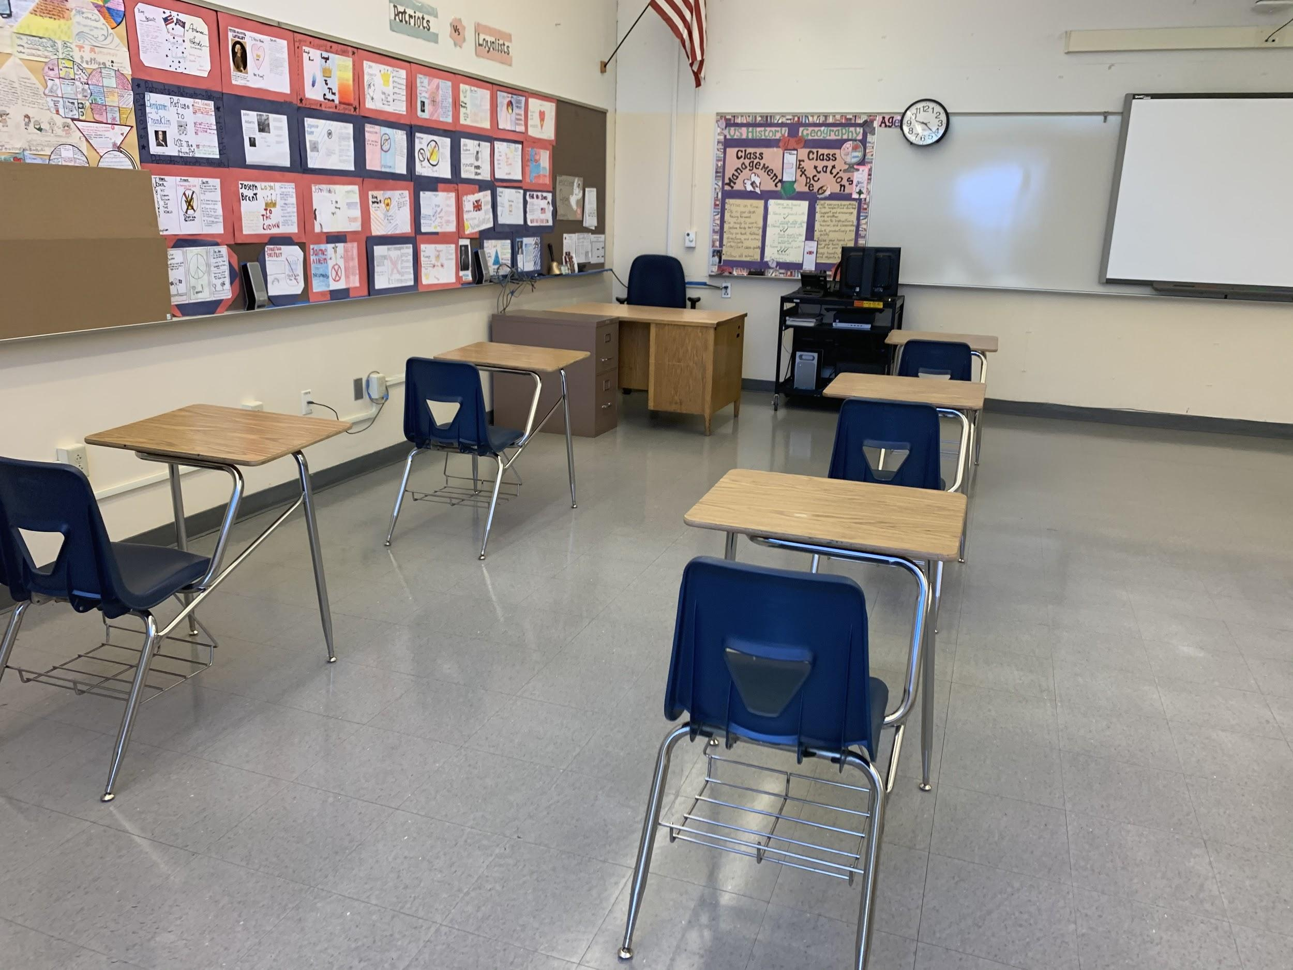
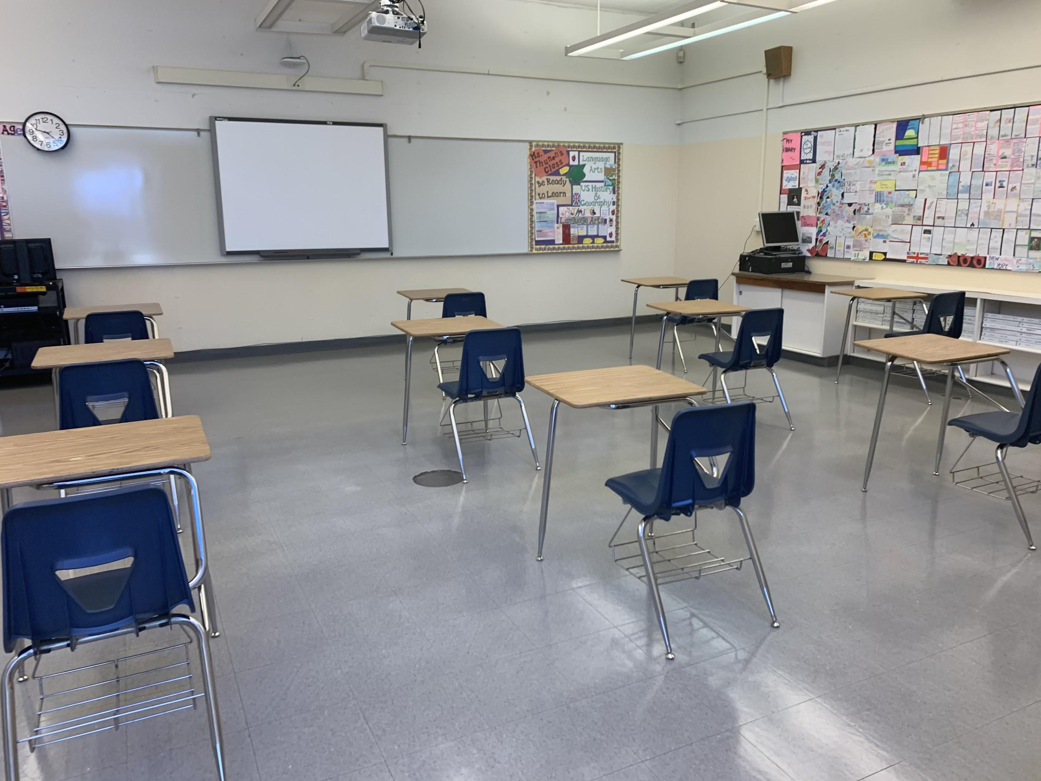
20-21 Reopening of Schools
Engagement Meeting with AAAB
7-1-2020
Notes:
Vincent/Steven/Jorge
Acknowledge this will be a lot of talking at people - will get to discussion as we move this work ahead

Slide 5
Purpose
The purpose of the Black/African American (BAA) Advisory Board is to advise the Board and Superintendent and relevant District Department designee(s) regarding accountability of services, programs, policies and resources that directly impact the district/school culture and climate of our classrooms and the academic, social/emotional and personal outcomes for B/AA students.
As an advisory group, members review, monitor, and evaluate the continuous improvement of the district's implementation of the Board adopted B/AA Task Force recommendations as of May 16, 2019, and consider other possible strategic areas as appropriate.

Slide 6
Responsibilities
Advise the policy and administrative entity of the district, special education local plan area, or county office, regarding the development, amendment, and review of the African American Task Force recommendations. The entity shall review and consider comments from the community and recommend annual priorities to be addressed by the Board of Education.
Establish and report on annual goals as outlined in Board-approved recommendations.
Meet monthly as a committee to:
Review district data
Monitor recommendation implementation and provide direction
Review strategic topics or current issues impacting the needs of African American students;
Monitor and assess academic and other student data as it is available (monthly, quarterly, tri-mester, annually)
Meet quarterly with the Superintendent and relevant District designee(s).
Establish sub-committees or task forces as appropriate to work on specific portions of the recommendations or other relevant topics.
Determine approach outreach to other stakeholders
Meet annually with the Board of Education.
Outreach and connect with the greater SCUSD B/AA community and parents/guardians.
Communicate to greater community on a quarterly basis regarding recommendation implementation and outcomes via minutes, newsletter and/or social media.

Slide 7
Governance Framework
Sacramento City USD
Administrative Regulation
Citizen Advisory Committees
AR 1220
Community Relations
The Superintendent or designee may create citizen advisory committees to advise the administration; such committees do not report to the Board and are not subject to open meeting laws.
(cf. 2230 - Representative and Deliberative Groups)
Regulation SACRAMENTO CITY UNIFIED SCHOOL DISTRICT
approved: November 16, 1998 Sacramento, California
reviewed: June 11, 2002
revised: June 2, 2015

Slide 8
DRAFT Black/African American Achievement Task Force Group Norms
Be familiar with the AAATF Transition Committee agenda provided by email; be prepared to participate
Come ready to be engaged
Follow committee guidelines and rules/includes consequences for not following the norms
There should be process (Process to be determined) to bring issues to the floor
Maintain confidentiality – when creating a group statement
Process for norm revisions defined
Allow everyone to have input and speak in turn
Suspend judgment until all of the facts are known
Stay on topic in discussion: use the parking lot for thoughts that are not on topic
Use evidence and data to drive inquiry and support recommendations
Provide one voice in Board Communications
Within the committee work, dissent and disagreement are healthy and should be encouraged
Be student-focused and trust that everyone comes with a desire to support students, the AAATF recommendations and implement the Task Force work
Listen to and respect each voice in turn
Listen with the intent to understand and not to respond
Be open to new ideas and questions
Honor and consider everyone’s voice and perspective
Have one conversation at a time – no sidebar conversations
Step Up, Self-Regulate and Step Back
Strive to attend all meetings; if you miss a meeting, it is your responsibility to find out what was covered.

Slide 9
Norms for Virtual Meetings
Do not multi-task (do other work) during the meeting.
Use the mute button at your site to prevent the transmission of background noise.
Speak up to get attention if you have something to say.
Turn on your video whenever possible.
Follow an organized line up to ensure each person has a chance to respond

Slide 10
African American Advisory Board Milestone Recap
September 27, 2018 - Convened African American Achievement Task Force
Met every Tuesday thereafter with few exceptions (October to May)
Retreat on January 18, 2019
Cross-walked recommendations to Graduation Task Force
November/December sponsored focus groups
Principals
Teachers
Students
Parents
March 19th – Community Engagement session at John Still
March 21st - Presented preliminary task force recommendations to board of education
May 16, 2019 – Board of Education Adopts Task Force recommendations
October 29, 2019 – African American Achievement Task Force – Transition Committee Launch
July 1, 2020 – African American Advisory Board Launch
Notes:
Convened community leaders on March 23, 2018 and May 7, 2018
Discussed CKM science project impact
Reviewed specialty program data
August 2nd - African American Achievement Initiative Board Presentation (Informationa

Slide 11
Setting the Context
Notes:
Vincent and Iris – What part was systemwide and what was mandated
2005-2007 – Culturally Responsive Pedagogy – with Sharroky Hollie (various schools)
Culturally Responsive Summer School (FKBK, Floyd, Kemble)
Culturally Responsive Train the Trainer
Culturally Responsive Model Classroom
2007-2009 – Courageous Conversations with Glenn Singleton
District Equity Leadership Team (DELT) developed
6-minute Equity videos for principals
Administrator Book Studies
2008-10 – Equity Access Achievement Task Force
Framework for Eliminating the Achievement Gap Recommendations
District-wide Equity Faire “Can We Talk About Race”
Summer Equity Training for Principals and Teachers
Each site developed site leadership plan for Closing the Achievement Gap
Equity Speaker Series
Jeff Duncan-Andrade
Mary Bacon
Pedro Noguera
Beverly Daniel Tatum
2011 – Cultural Proficiency with Randall Lindsey
2013 – Achievement Gap Coalition Recommendations & Restorative Justice Collaborative

Slide 12
Setting the Context - Present
Blacks Making A Difference

Slide 13
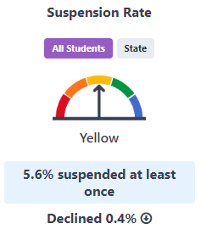
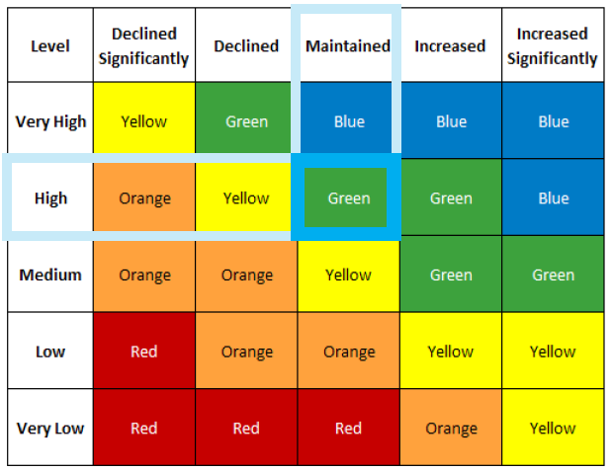
Defining ‘Performance’
‘Performance’ on the Dashboard is a combination of ‘Status’ (student outcome in the most recent year) and ‘Change’ (the year-over-year change from the prior student outcome).
By measuring ‘Change’ and factoring it into the Dashboard performance rating (color), the state has prioritized growth/progress over time. This also means that a school/district/student group’s color rating in a given indicator is not equivalent to a simple, numerical performance outcome such as ‘85% graduation rate’ or ‘10% Chronic Absenteeism Rate.’
Notes:
Mary and Chad
Ongoing monitoring of Graduation and A-G progress
Align communication between principal, assistant principal and counselor to ensure streamline process in supporting sites in their intervention plans
Expanded Learning Summer Program (2020)
Greater Efficiency
attention via weekly monitoring for credit recovery
We are also currently pre-registering current 9-11 graders to help ensure they are graduation ready
Ensure accurate data is input into IC and UC Merced tools and proper student exit codes are used
Ensure course sections are created accurately for A-G and College Career Readiness reporting purposes

Slide 14
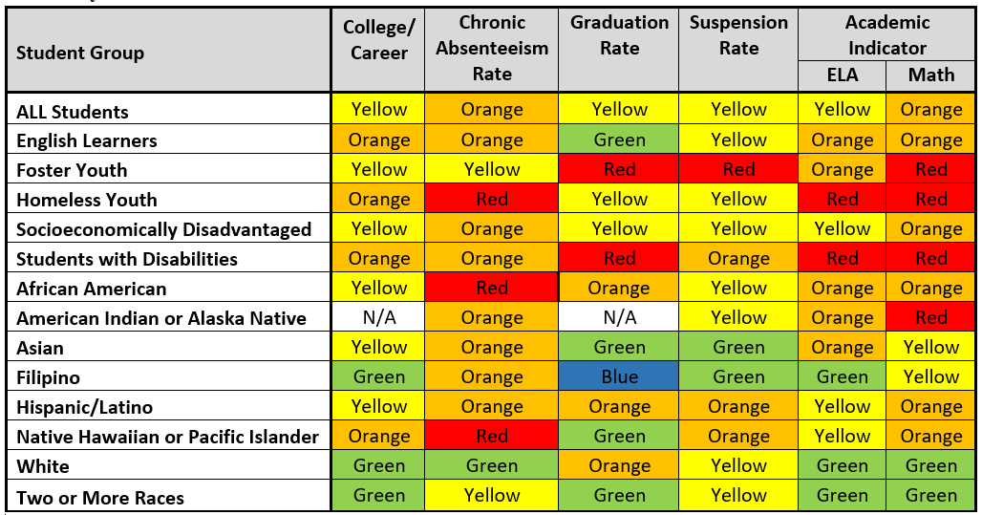
2019 Dashboard Results

Slide 15
Recommendation Review
Review Recommendations
Reshape the recommendations based on the current reality
Discuss potential measures in lieu of the spring 2020 SBAC (Spring 2020 SBAC suspended due to COVID-19)
How do we review the recommendations in the context
Created pre-Covid-19
Currently in Covid-19
What comes next after Covid-19
Recommendations Committee: Kenya, Nakeisha, Ursula, Julius

Slide 16
Overarching Outcomes By June 30, 2020 and each year thereafter, SCUSD will decrease the percentage of non-proficient students by 5%*
Increase 3rd grade SBAC met or exceeded for Black or African American students:
In Mathematics from 17% in 2017-18 to 25%* in 2019-20. (21% in 2018-19)
In English Language Arts from 18% in 2017-18 to 27%* in 2019-20. (22% in 2018-19)
Increase 6th grade SBAC met or exceeded for Black or African American students:
In Mathematics from 15% in 2017-18 to 24%* in 2019-20. (15% in 2018-19)
In English Language Arts from 19% in 2017-18 to 27%* in 2019-20. (25% in 2018-19)
Increase 8th grade SBAC met or exceeded for Black or African American students:
In Mathematics from 16% in 2017-18 to 24%* in 2019-20. (11% in 2018-19)
In English Language Arts from 29% in 2017-18 to 36%* in 2019-20. (21% in 2018-19)
Increase 4-year cohort graduation rate from 74.1% in 2017-18 to 76.7%* in 2019-20.
2018-19 4-year cohort graduation rate is 71.8%
Increase 4-year A-G course completion from 45.9% in 2017-18 to 48.6%* in 2019-20.
2018-19 4-year cohort A-G rate is 45.2%
*The 2019-20 goal represents a reduction of 10 percent of the percent of students who did not achieve the desired goal in 2017-18. For example, if 20% met the desired goal previously, a total of 80% did not meet the goal. Ten percent of the 80% that did not meet the goal is 8 percentage points. Adding the 8 percentage points to the 20% who previously met the goal equals a hypothetical new goal of 28% for the current year. For each year thereafter 2019-20, the goal is to decrease the percent of non-proficient students by 5%.
Source: DataQuest, based on “All Schools” as the “School Type”
Notes:
Lynn
(2018 - Math – 74 students, or 17.25%; ELA – 76 students, 17.71%) to (number and percentage) https://caaspp.cde.ca.gov/sb2018/ViewReport?ps=true&lstTestYear=2018&lstTestType=B&lstGroup=5&lstCounty=34&lstDistrict=67439-000&lstSchool=0000000
(Current 6th graders who met or exceeded standard: Math – 70 students, or 14.9%; ELA – 91 students, or 19.5%. Current 8th graders who met or exceeded standard: Math - 74 students, or 16.4%; ELA – 131 students, or 29.1%.)
https://caaspp.cde.ca.gov/sb2018/ChangeReport?ps=true&lstTestYear=2018&lstTestType=B&lstGroup=1&lstCounty=34&lstDistrict=67439-000&lstSchool=0000000&lstGrade=6
https://caaspp.cde.ca.gov/sb2018/ChangeReport?ps=true&lstTestYear=2018&lstTestType=B&lstGroup=1&lstCounty=34&lstDistrict=67439-000&lstSchool=0000000&lstGrade=8
https://caaspp.cde.ca.gov/sb2018/ViewReport?ps=true&lstTestYear=2018&lstTestType=B&lstGroup=5&lstCounty=34&lstDistrict=67439-000&lstSchool=0000000
(Current graduation numbers 2016-17 – 443 AfAm graduates, or 16% of all graduates; 178 of which completed UC/CSU requirements, or 40.2%)

Slide 17
Recommendation Implementation Time Horizon
Recommendation | Up to 1 Year | Up to 2 Years | Up to 3 Years
Establish a District-wide Black/African American Parent/Caregiver and Student Advisory Board | x
Establish a Black/African American Student Achievement Task Force Implementation/Accountability/Parent Engagement Steering Sub – Committee (s) | x
Require sites with over 5% variance on suspension rate disproportionality to develop and implement a plan to reduce suspensions to at least the district average | x
Eliminate willful defiance suspensions (Senate Bill 419) | x
Implement multiple measures to assess student progress in order to identify students in need of intervention and prioritize resources | x
Implement research based intervention and acceleration strategies to close persistent learning gaps | x
Provide school-to-college and school-to-career experiences utilizing community stakeholders (career training, university shadowing, mentoring and internships, etc.) | x
Divest from future funding for school resource officers and reinvest in alternative supports | x
Create a District-wide study team tasked to review, monitor K-12 special education referral practices | x | x
Adopt and implement curriculum that includes and reflects Black/African American experience | x | x
Provide professional development addressing inequitable disciplinary practices and mandate 100% faculty and staff attendance | x | x | x
Eliminate Pre K – 3rd grade suspensions | x | x | x
Increase Black/African American teachers from 109 to 150 | x | x | x
Notes:
Cassandra

Slide 18
Recommendation Implementation Status
Recommendation | Implementation Underway | Implementation Being Evaluated | Not Started
Establish a District-wide Black/African American Parent/Caregiver and Student Advisory Board | x
Establish a Black/African American Student Achievement Task Force Implementation/Accountability/Parent Engagement Steering Committee |  |  | x
Require sites with over 5% variance on suspension rate disproportionality to develop and implement a plan to reduce suspensions to at least the district average | x
Eliminate willful defiance suspensions (Senate Bill 419) |  | x
Implement multiple measures to assess student progress in order to identify students in need of intervention and prioritize resources |  | x
Implement research based intervention and acceleration strategies to close persistent learning gaps |  |  | x
Provide school-to-college and school-to-career experiences utilizing community stakeholders (career training, university shadowing, mentoring and internships, etc.) |  | x
Divest from future funding for school resource officers and reinvest in alternative supports | x
Create a District-wide study team tasked to review, monitor K-12 special education referral practices |  |  | x
Adopt and implement curriculum that includes and reflects Black/African American experience |  |  | x
Provide professional development addressing inequitable disciplinary practices and mandate 100% faculty and staff attendance |  |  | x
Eliminate Pre K – 3rd grade suspensions |  |  | x
Increase Black/African American teachers from 109 to 150 |  |  | x
Notes:
Cassandra

Slide 19
Launch Governance Structure Work Group
Who facilitates the meeting?
Who documents the meeting?
Who ensures that the process is followed?
How are decisions made?
What is the district role?
Committee members: Darryl, Benita, Cassandra
Goal is to present a draft framework at 8/5 Meeting

Slide 20
2020-2021 AAAB Meeting Calendar
Monthly Meeting Day
1st Wednesday of the Month (Next Meetings: August 5th, September 2nd, October 7th , November 4th and December 2nd)
Meeting Time and Length
90 Minutes (Standing Meeting-Starting September)
5:30PM to 7PM
Ask the superintendent to return on 8/5 for a re-opening update
120 Minutes
5:30PM to 7:30PM
Invite members to CAC meeting – on-line in September (Black students with disabilities have the highest suspension and expulsion rate)
Meeting Location (s)
Zoom – Until
In person/Serna – depending on climate with social distancing
In person/Serna and zoom with social distancing
In person at restaurant with social distancing – to commune as a community and outside the institution that bind us (at some point)

Slide 21
THANK YOU

Slide 22
Appendix

Slide 23
Revised Organizational Structure and Governance
B/AA TF Advisory Board
(meets quarterly as a group and annually with BOE)
District Liaison
Parent Engagement Committee
Communication Committee
B/AATF Executive Committee
(meets monthly)
Notes:
-Like the overall framework – consider integrating a technology component to build outreach capacity
-Consider changing the name from communication to community engagement committee
-Need to emphasize the specific competency – communication is more action oriented – sharing information, sharing policies, sharing important messaging – community engagement has a wide interpretation
-Intention to ensure whatever this advisory board is doing that there is an outward facing
-Goal is to share outcomes with the greater African American community in Sac City Unified
-Communicating, Informing, Advocating, Seeking information, (Outward Voice)
-consider calling this communication and community outreach and research
-We need to keep it simple – perhaps we start with a more blank slate and then add more context as we evolve
-We might give more consideration to the meaning of “research” as we evolve
-We need your commitment forms to manage the mix of board members
-It is important to feel settled in the work – we can use all of our words in the description if it helps settle us

Slide 24
WHAT AND WHY
The purpose of the B/AA Advisory Board is to advise the Board and Superintendent and relevant District Department designee regarding services, programs, and policies and resources (potentially list a series of “such as”) offered that directly impact the Academic /Social Emotional Academic Learning outcomes of B/AA students. by the school district that serve.
As an advisory group, members review, monitor, and evaluate the continuous improvement the district's implementation of the Board approved B/AA Task Force recommendations as of May 16 , 2019 and consider other possible strategic areas as appropriate
The Board membership is to include representation of District (department leaders representing recommendation focus areas) and school site staff, parents/guardians of B/AA students , B/AA community members, leaders and organizations throughout the District, with a specific outreach effort to include families, students and organizations that reflect the diversity of the intersection of the B/AA community (socio-economic, foster, homeless, exceptional needs).
The largest group represented on the Advisory Board will be represented by…
At least 51% percent of the total Advisory Committee/Board membership committee must be made up of parents/guardians of B/AA and B/AA students who are not employed by the district.

Slide 25
WHO?
Advisory Board/Committee Composition
9-11 Parent/Guardians
Up to 4 Students – (9-12)
8-10 Community Partners (including original task force members)
Total Voting Task Force Members – 21-25 Members
District staff would participate as content support and progress monitoring recommendations

Slide 26
WHO?
Community leaders, community based organizations, non-profit and/or government agencies
Vision 2000
Building Healthy Communities
Greater Sacramento Urban League
Black Parallel School Board
Sacramento NAACP
Improve Your Tomorrow
Organizations in the zip codes with the greatest impact (e.g. Meadowview, Valley High/Mack Road, Oak Park, etc.)
Promise Neighborhood
Faith Based Organizations
Black Pastors Network
Sacramento ACT

Slide 27
Who is Missing? How do we reach out?

Slide 28
THANK YOU

