Slide 1
District English Language Advisory Committee
DATE : March 18, 2024
TIME: 5:30-7:30 PM
South Carolina Meeting Room

Slide 2
Big bold statement slide
Every system is perfectly designed to get the results it gets
SCUSD Core Value
We recognize that our system is inequitable by design and we vigilantly work to confront and interrupt inequities that exist to level the playing field and provide opportunities for everyone to learn, grow and reach their greatness.
SCUSD GUIDING PRINCIPLE
All students are given
an equal opportunity to graduate
with the greatest number of postsecondary choices
from the widest array of options
Notes:
Mr. MD

Slide 3
Multilingual Literacy Department Outcomes
All emergent bilingual students improve on their overall Summative ELPAC Assessments by at least one performance level.
All emergent bilingual students improve on their CAASPP ELA assessments noted by the student’s scale score (3-8th CAASPP, 11th CAASPP);iReady ELA
Increase reclassification by 10% on a yearly basis.
90% of EBs will graduate from high school.
80% of High School Emergent bilingual students will be on track for college and career (students meeting A-G requirements).
All schools serving at least 21 or more emergent bilingual students will have a functional English Language Advisory Committee (ELAC).
Notes:
Mr. MD

Slide 4
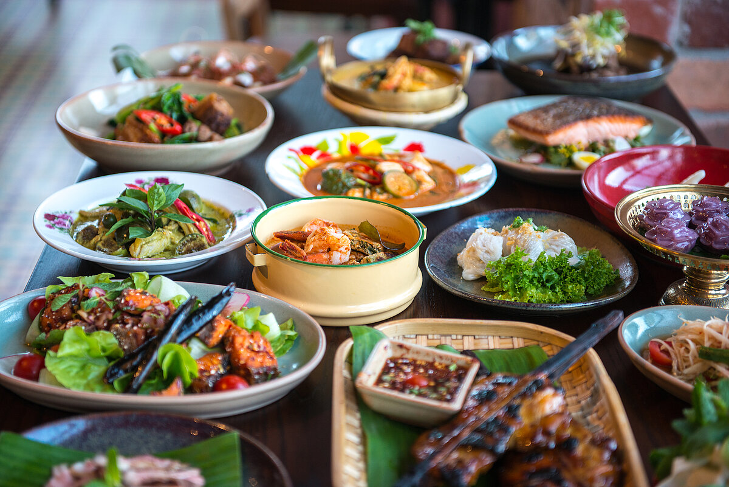



COMMUNITY CONNECTOR: What is your favorite food? Why?
Notes:
Mrs. Farias

Slide 5

DELAC REPRESENTATIVE ROLL CALL
Notes:
Ms. Sujey

Slide 6
APPROVAL OF MEETING MINUTES
Monday, February 5, 2024
https://drive.google.com/file/d/18TFEPnGyCG1jyr-PYVh9YRqf8LTspCbx/view?usp=sharing
Notes:
Mr. MD

Slide 7
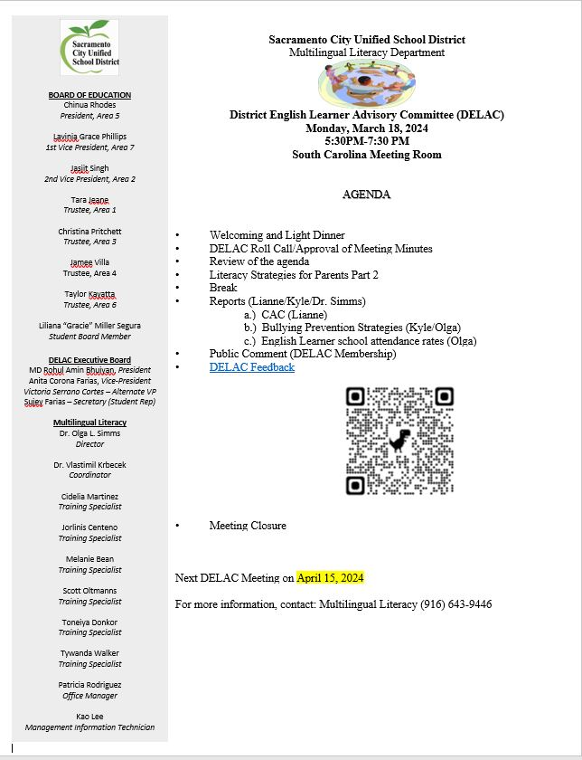
Notes:
Ms. Sujey

Slide 8
Literacy Strategies for Parents (Part 2)

Slide 9




Ways to Support Your Student at Home Grades K-3
Model fluent reading with your child
Have conversations before, during, and after reading together
Generate questions and concerns to share with your child’s teacher
Echo Reading | Echo Reading - Kinder
Reading Together | Read Together - Kinder
High Frequency Words | High Frequency Words - Kinder
Audio Books | Audio Books
Graphic Novels | Graphic Novel Titles

Slide 10


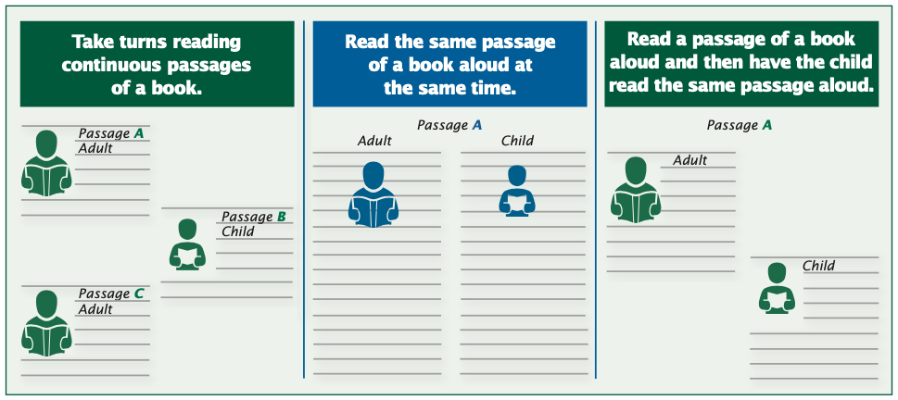


Ways to Support Your Student At Home
Grades 4-8
With older students read paragraphs and/or pages.

Slide 11

Questions to Ask Before, During, and After Reading
Informational
Narratives (Stories)
What is the main idea?
What caused _______ to happen? Why?
Can you make a connection?
Do you notice a pattern?
Who is the main character in the story
What is the problem/issue?
Why did the character do what he did?
What else could she have done?
How did they solve the problem/issue?

Slide 12
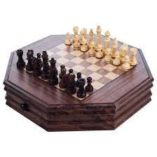
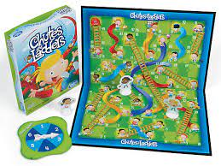
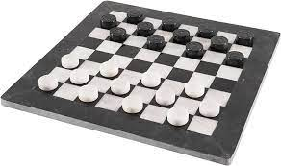
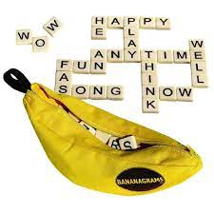

Board Games Provide an Opportunity
for Language Stimulation
Benefits
Game Ideas
Expands Vocabulary
Helps with Following Direction
Encourages Teamwork
Creative Capacity
Strategic Thinking
Logical Thinking
Memory
Mental Calculation
Reading
Cooperation
Keeps Attention
Chess
Checkers
Charades
Pictionary/Pictionary Jr.
Chutes and Ladders
Blokus
Double Ditto
Scrabble
Rory’s Story Cubes
Bananagrams
Dixit
Hangman

Slide 13





Free Mobile Phone Word Puzzles
Wordscapes is one of a few great puzzle apps, combining creating words with a crossword puzzle. You just swipe to connect the letters to create words that fit.
Wordle..players have six attempts to guess a five-letter word, with feedback given for each guess in the form of colored tiles indicating when letters match or occupy the correct position.
Pictoword is built around a simple premise: you have to guess a word and are given two pictures which give you a clue as to what that word might be.
Apple
Android

Slide 14

BREAK: 10 Minutes
14
Notes:
Suje

Slide 15
Bullying Prevention
Notes:
Mr. MD

Slide 16
Community Advisory Committee (CAC)
Notes:
Mrs. Farias

Slide 17
English Learner Student Attendance

Slide 18
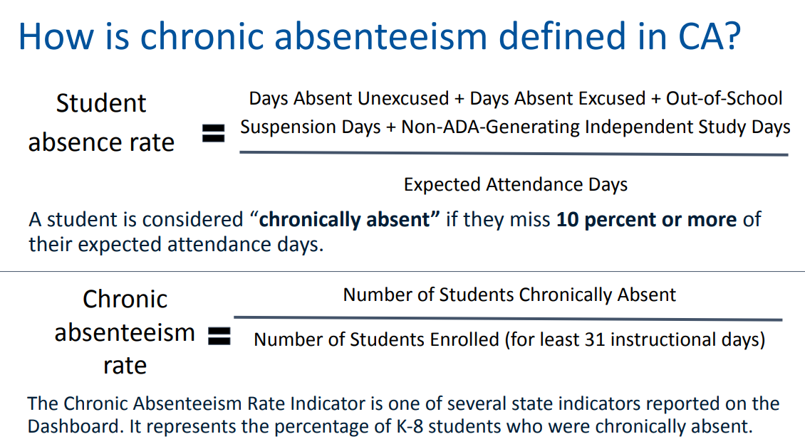
Student Attendance and Chronic Absenteeism
PACE, 2024

Slide 19
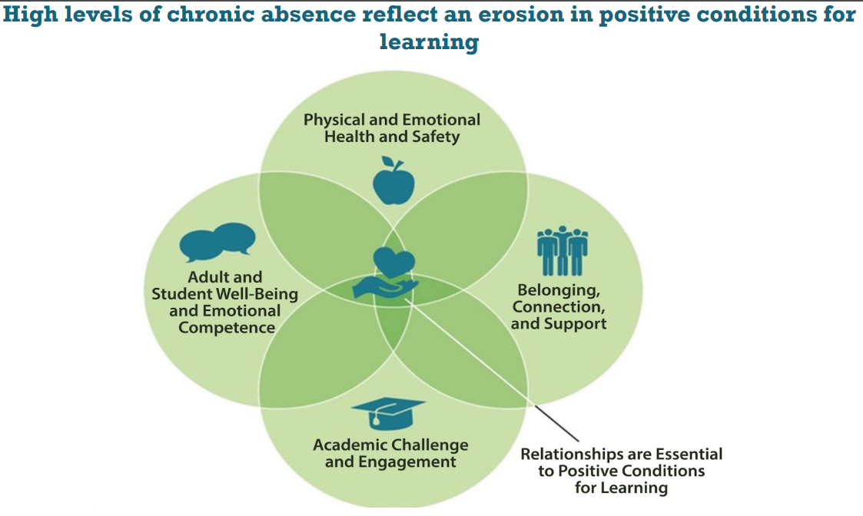
Why is monitoring attendance important?
www.attendanceworks.org

Slide 20
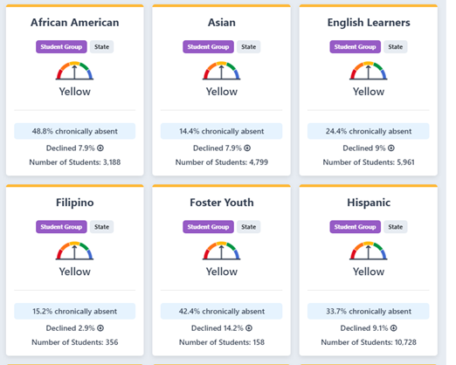
California Dashboard Attendance Metric

Slide 21
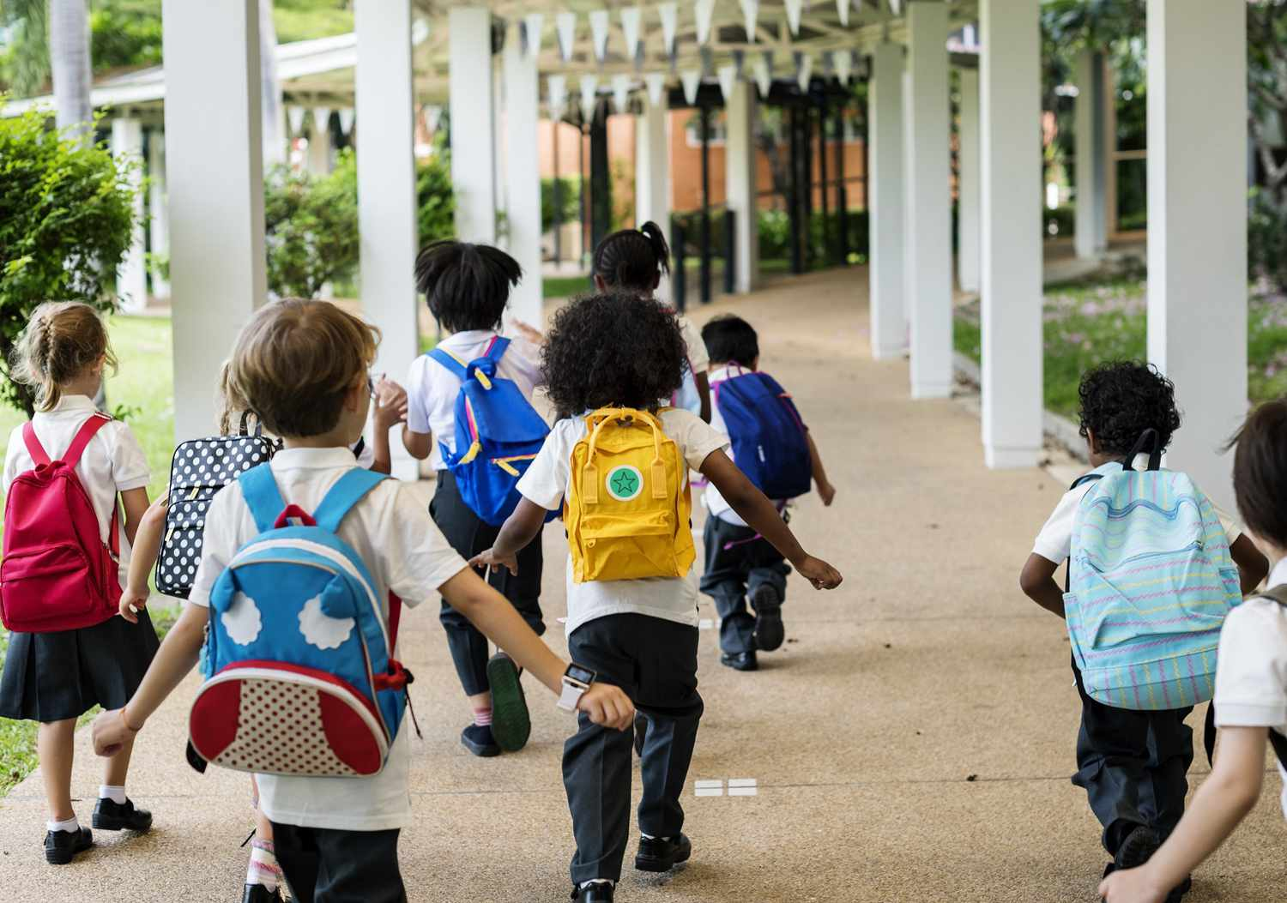

Slide 22
Needs Assessment Results
1. Importance of Regular School Attendance
2. Strategies/Questions for Parent-Teacher
3. Bullying/Cyber Bullying
4. Study Skills, homework strategies
5. Reclassification
Notes:
Mrs. Victoria, Dr. Simms

Slide 23
PUBLIC COMMENT
Notes:
Ms. Anita

Slide 24
Public Comment
DELAC PUBLIC COMMENT

Slide 25

Breathe and Exhale (4 Times)
Notes:
We will continue to work on communication skills, Olga

Slide 26
DELAC FEEDBACK
Notes:
Mr. MD

Slide 27
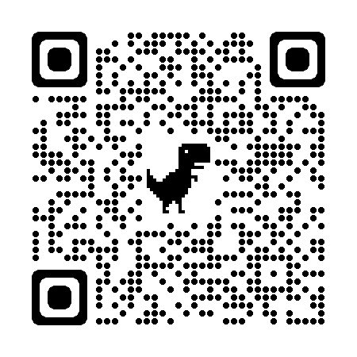
DELAC Feedback QR CODE
DELAC FEEDBACK LINK
Notes:
Mr. MD

Slide 28

Community Closing Activity
GRATITUDES…
Notes:
Mr. MD and Ms. Victoria

Slide 29

Upcoming Meetings:
DELAC-South Carolina Room
Monday, March 18, 5:30-7:30 p.m.
Monday, April 15, 5:30-7:30 p.m.
MPAC- Zoom
Monday , March 11th , 6:00 p.m. - 7:30 p.m.
zoom jorlinis-centeno@scusd.edu
Monday, April 22nd, 6:00 p.m. - 7:30 p.m.
SCUSD BOARD MEETINGS- Community Rooms
Thursday, February 1, 6:30 p.m.
JOINT PAC/BAAAB/CAC/DELAC Mtg.-South Carolina
Notes:
Mr. MD and Ms. Victoria

