Slide 1

Transition To The Common Core
Transforming Teaching & Learning
K - 2
May 23, 2014

Slide 2

What numbers are missing in the boxes shown?
Notes:
What standard/s would a question like this address??

Slide 3
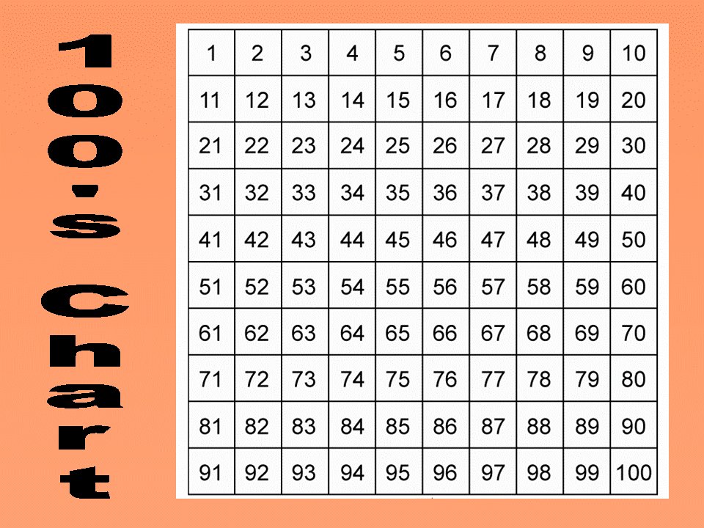

Slide 4
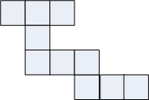
The number 43 is covered by pieces like these shown below. What other numbers might be covered?
Notes:
What would a student need to know and understand to be able to complete this task?

Slide 5
How could a student use a hundreds chart to solve:
34 – 9 =
77 – 28 =
Notes:
What insights would a formative assessment question like this give you?
Could we level the complexity of these strategies? What teaching points would come out of observations/

Slide 6
Why use the Hundreds Chart?
It is a framework for students to think about our base ten system and to build a mental model of the mathematical structure of our system.
Hundreds charts allow children to explore concepts from counting to adding two-digit numbers.
It should be an interactive tool used and internalized by the students.
Conklin & Sheffield, 2012
Notes:
Research has shown that persisting with counting by ones to add and subtract is a characteristic of students who do not make adequate progress in mathematics. For example, when asked the number that is ten more than 23 they touch or say each number until they get to 33.

Slide 7
How could the hundreds chart be used to support the following standards:
K.CC.1. Count to 100 by ones and by tens.
1.NBT.4. Add within 100, including adding a two-digit number and a one-digit number, and adding a two-digit number and a multiple of 10.
2.NBT.5. Fluently add and subtract within 100 using strategies based on place value, properties of operations, and/or the relationship between addition and subtraction.
Notes:
How can we link the 100’s Chart to the work we explored on the number line?? What experience do students at each year level need to have with the 100’s chart to ensure they are prepared for the next level of understanding?
Counting, Concrete Computation, Leading to visualizing and mental strategies.
http://www.oswego.org/ocsd-web/games/DogBone/gamebone.html

Slide 8
Outcomes
Participants will:
Connect content standards to content pedagogy.
Celebrate successes.
Connect the use of manipulatives and the Standards for Mathematical Practice.
Analyze the curriculum map and use it to plan for coherent, cohesive and connected instruction.
Notes:
What is the intent of bullet #3?

Slide 9
Agenda
Warm-Up
Celebrating Success
Manipulatives and the Standards for Mathematical Practice
Curriculum Maps
Notes:
Joy

Slide 10
Celebrate Success – Share Your Common Core Story
Growth vs. Fixed Mindset
Formative Assessment – Feedback that moves Learning Forward
Talk Moves/Productive Talk
Open-Ended Questions
Standards for Mathematical Practice
Today’s Number – Tell Me All You Know About …
Problem-Solving Strategies
My Favorite No – Valuing Wrong Answers
Backward Lesson Design
Number Lines
Content Analysis
Wikispace
Notes:
Think
Musical Shares
Return to table – share something that you heard that you are excited to incorporate instructionally either as a school or individually
Share out intention as a whole group.

Slide 11
Manipulatives
Concrete thinking
Build understanding
Standards for Mathematical Practice 1, 4, 5, 6.
Notes:
Think
Musical Shares
Return to table – share something that you heard that you are excited to incorporate instructionally either as a school or individually
Share out intention as a whole group.

Slide 12
Curriculum Maps – What Are They?
Independently study the curriculum map
Then answer Questions 1 and 2 on Curriculum Map Guiding Questions sheet.
Benefits of Curriculum Maps
Unit 1 – Examine it more closely and use your observations to answer Question 3.
Notes:
First Bullet – About 7 minutes. Then share with table. Then share out each question separately. Use Add on and agree or disagree.
Second Bullet – Benefits – About 7 minutes. At table, each person complete one section. Then share ideas around the table. . One person share Teacher Benefits – others to add on. One person share Student Benefits – others to add on. And so on.
Third Bullet – Work with a partner – each writing your observations on your own paper. Share your observations with another partner pair.

Slide 13
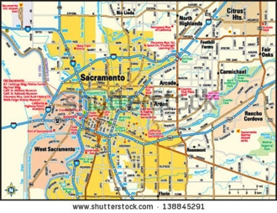
Curriculum Maps – What Are They?
Notes:
Joy
Curriculum Maps are like a road map – set a course – don’t define every stop and every turn.

Slide 14

Break
Notes:
Physically move yourself and all of your materials to grade specific groups – where you will spend the majority of the rest of the day – where you will be immersed in using the curriculum map for the purpose of preparing for instructional planning.
Shut the doors most of the way.

Slide 15
Curriculum Maps – How are They Used to Plan for Instruction?
Two objectives:
Model the process of using the curriculum map to prepare for creating a learning unit and lesson planning.
Provide feedback on the curriculum map – Use Plus/Delta Recording Sheet

Slide 16
Why Plan Units of Study?
Think, Pair, Share
Think – Using “Why Plan Units of Study” sheet, prioritize the benefits by selecting your personal Top 3.
Pair – Share your Top 3 and your reasons for the selections with another person at your table.
Share – Share with whole group.

Slide 17
Why Plan Units of Study?
In short…
You can’t outsource your thinking to anyone or anything!

Slide 18
Curriculum Maps – How are They Used to Plan for Instruction?
Unit 1
Close Reading – Read with a pen
Content Analysis
1. Read the actual complete text of the standards to which this unit is aligned.
2. Use Resource column – study standards support tools to deepen understanding of what the content standards mean
Notes:
Cannot outsource the thinking required to build a coherent, cohesive, connected instructional unit – As a teacher you must replicate the thinking used to create the curriculum map so that you are well-grounded in both the content and the pedagogy for teaching that content
Be specific and intentional about the time it takes to do this – our process today will be lengthy – as we are explicit about each part of the process. In practice, it will be smooth and one step will flow into another – collaboration will make the process more efficient.

Slide 19

Lunch

Slide 20
Curriculum Maps – How are They Used to Plan for Instruction?
Unit 1
Answer the essential questions
Do the items/tasks in the assessment column
Examine/Analyze the Sequence of Learning Experiences and the Instructional Strategies – use them to create a cohesive and connected sequence of lessons
Notes:
Click on one bullet at a time – giving participants ample time to collaborate and complete the bulleted task.
Consider common post assessment.
Bullet 3 – Use Lesson Sequence handout

Slide 21
Curriculum Maps – How are They Used to Plan for Instruction?
Unit 1
Fully develop one lesson of the sequence incorporating at least specific instructional or content pedagogy strategy learned this year.
- Use SCUSD Lesson Plan Template as a guide.
- Share with your training specialist.
Notes:
In small group – divide up the lessons – work together – on one today – collaborate on the development of others – using technology and your training specialist.

Slide 22
Curriculum Maps – How are They Used to Plan for Instruction?
March Content Analysis
Find the unit aligned to the content cluster which you studied in March.
Use a second +/ to provide feedback.

Slide 23
Moving Forward - CCSSM
What are the obstacles/possible solutions to implementing curriculum maps?
  - In your classroom?
  - In your grade?
  - In your school?
Notes:
We have worked with the benefits of using a curriculum map as our instructional guide throughout the day – it may be a change in our practice/process for preparing for instruction – consider –

Slide 24
Moving Forward
“Teachers are the key to children’s math learning, the conduits between the child and the math curriculum.”
Marilyn Burns, Leading The Way

