Slide 1
Playground Care
Sacramento City USD

Slide 2
Our playgrounds!
Following assessment done on all playgrounds, Facilities will categorize them for future replacement.
SIA’s CPSI and ADA team is available to assist Risk Mgmt and Facilities with inspections and on replacement projects.
M&O will continue to address immediate repairs needed before school year resumes.
Work orders are promptly addressed on unsafe findings.
SIA will continue to schedule yearly Spring and Fall inspections, and custodial staff are required to do routine playground checks throughout the year.

Slide 3
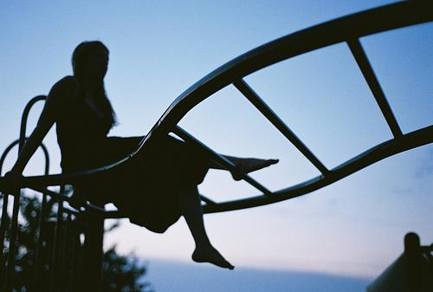
Custodian Role
Important role in daily update and keeping children safe
Daily:
Rake exit areas of slides and under monkey bars
Make sure footings of structure are not exposed
Visual inspection EACH DAY
Monthly:
Complete checklist
Look for missing bolts, cracks, loose components, vandalism, environmental issues
Send copy to Risk Management

Slide 4
California Regulations
Since 2000, all public playgrounds were required to meet California regulations
All playgrounds must comply with:
California Health & Safety Code, Section 115725-115735
ASTM standards: F1487, F1292, F1951
U.S. Consumer Product Safety Commission (CPSC) Handbook for Public Playgrounds #325
2022 California Building Code Chapter 11B accessibility standards and 2010 ADA Standards for Accessible design

Slide 5
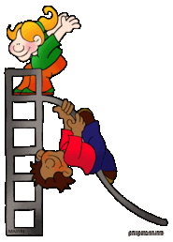
Why is Maintenance Important?
Poor maintenance of equipment is cited as the second leading factor in playground injuries after improper use/poor supervision
79% of all playground injuries are due to falls

Slide 6
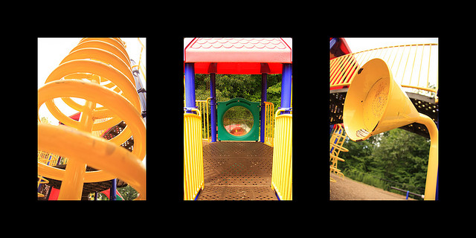
Purpose of inspections
Safety – ensure safety of users
Function – keep equipment operational
Aesthetics – clean, attractive and sanitary
GOAL: Be proactive, not reactive

Slide 7
Inspections
Daily – visual
Weekly – check fall material
Monthly – check equipment
Annually - fall material refills
Document all inspections!
If it isn’t written down, it didn’t happen
Take credit for the work you are doing!

Slide 8
Recognizing hazards: Container box
Low fall material
Debris in box
Trip hazards
Damage and wear to box structure

Slide 9
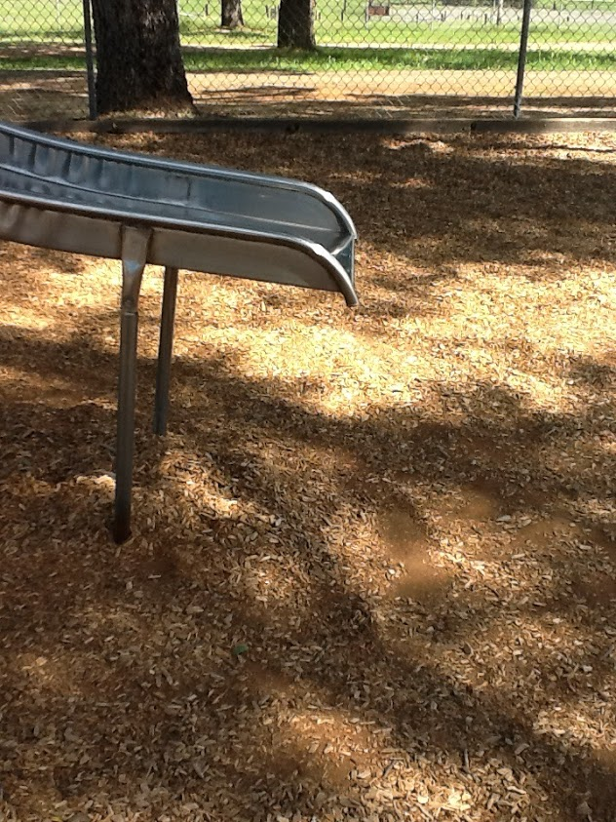
Height of slide exit to protective surfacing shall not be:
More than 11 inches if the slide height is 4 feet or less OR
Between 7 and 15 inches if slide height is great than 4 feet.

Slide 10
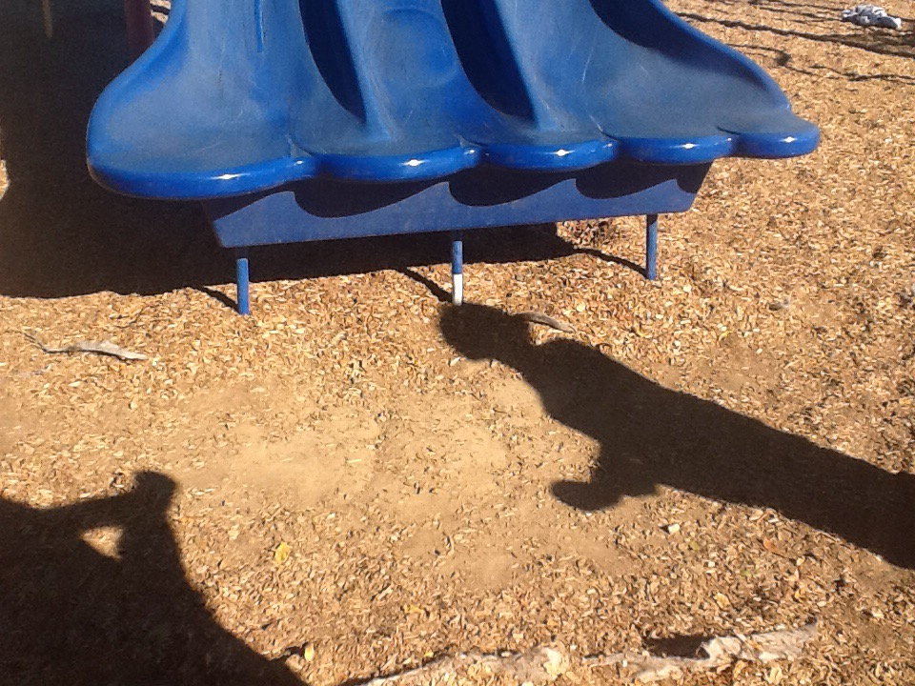
24”

Slide 11
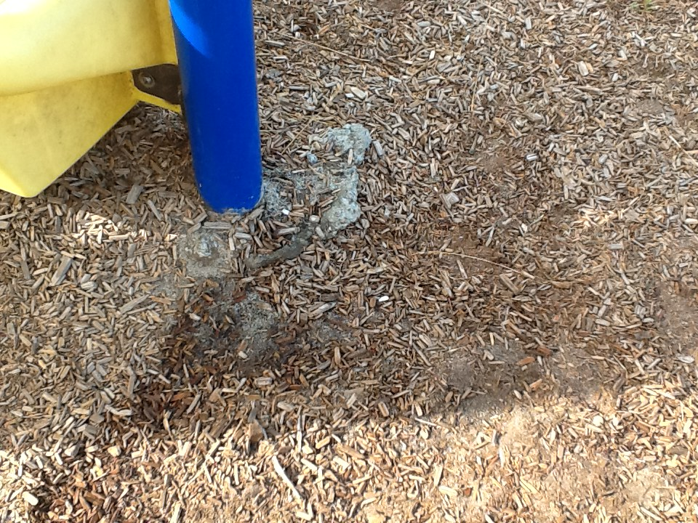
Exposed footings indicate low loose protective surfacing material

Slide 12
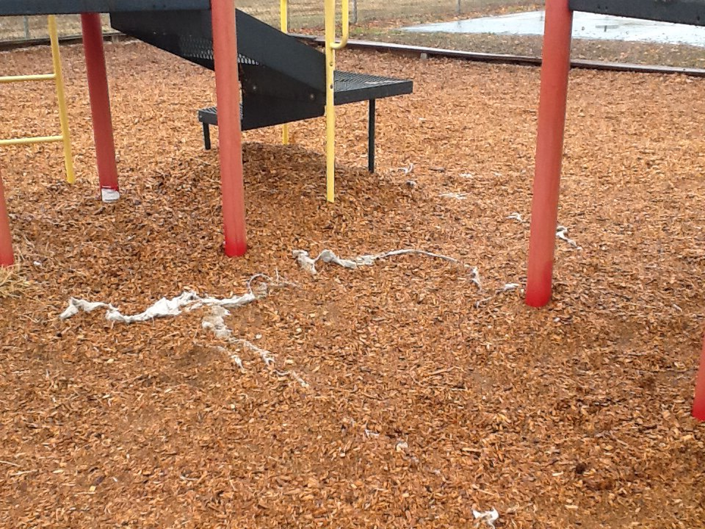
Exposed weed barrier material indicates low loose protective surfacing

Slide 13
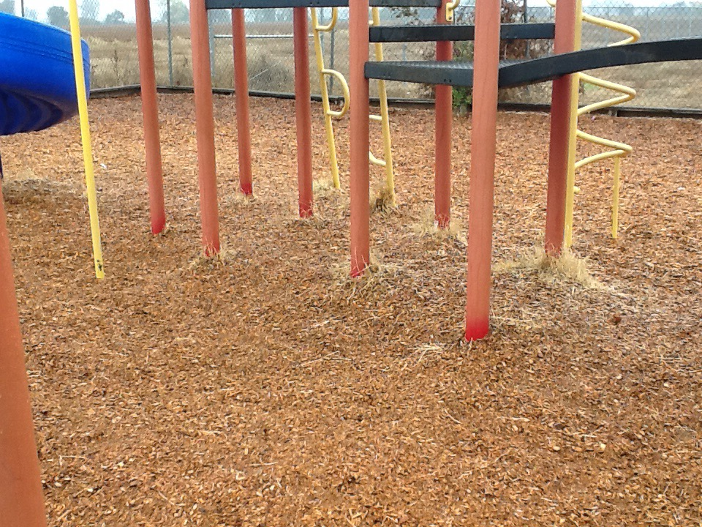
Weeds and other organic growth indicates lack of maintenance

Slide 14
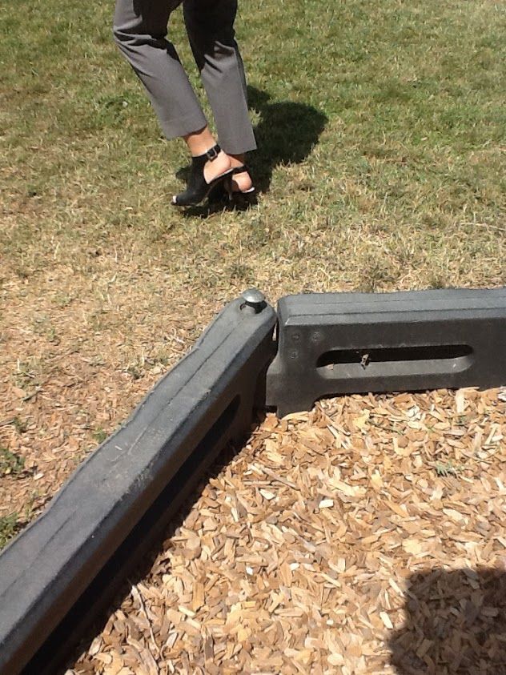
Watch for loose connections and exposed damage on container box materials.

Slide 15
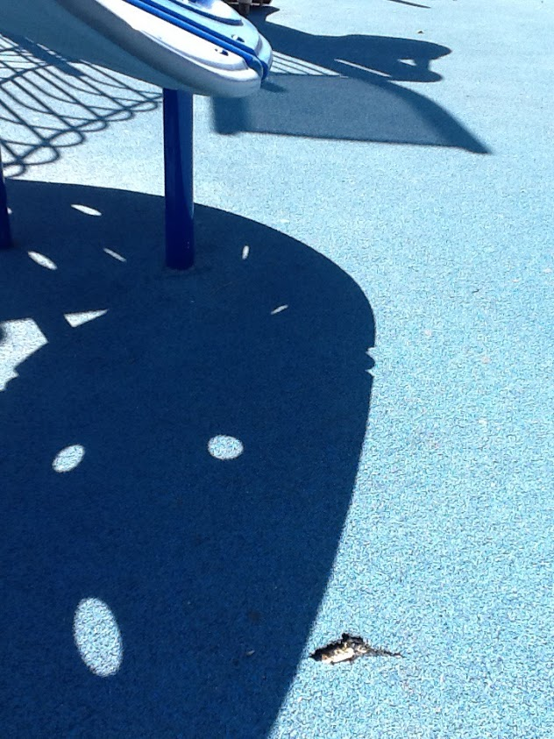
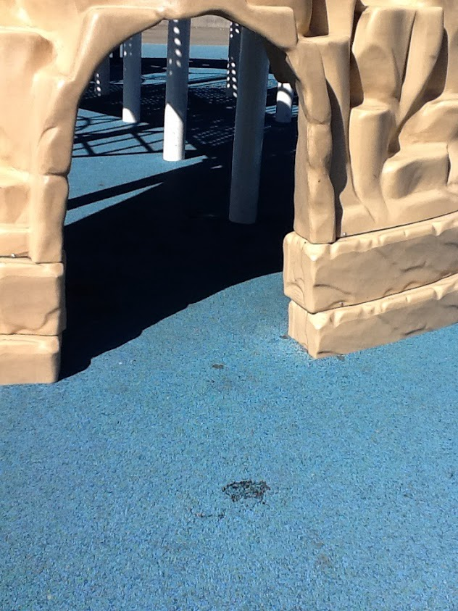
Repair torn unitary surfacing early to prevent further damage

Slide 16
Recognizing hazards: Equipment
Damaged equipment
Vandalism or missing components
Metal surfaces
Sharp edges
Moving parts
Worn “S” hooks
Hardware
Protruding bolts
Missing or loose hardware

Slide 17
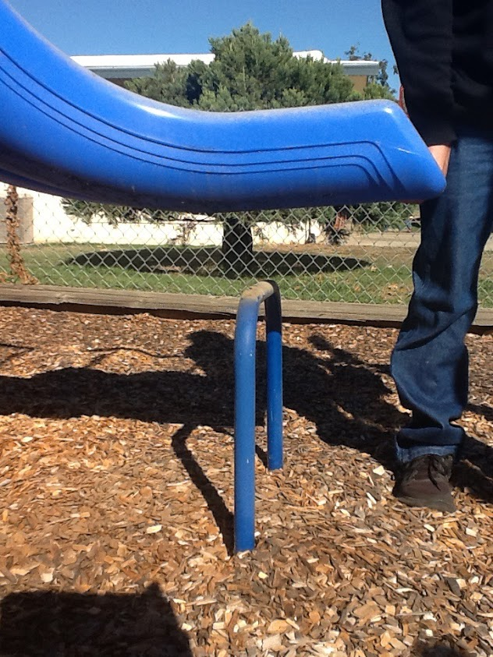
Watch for missing hardware

Slide 18
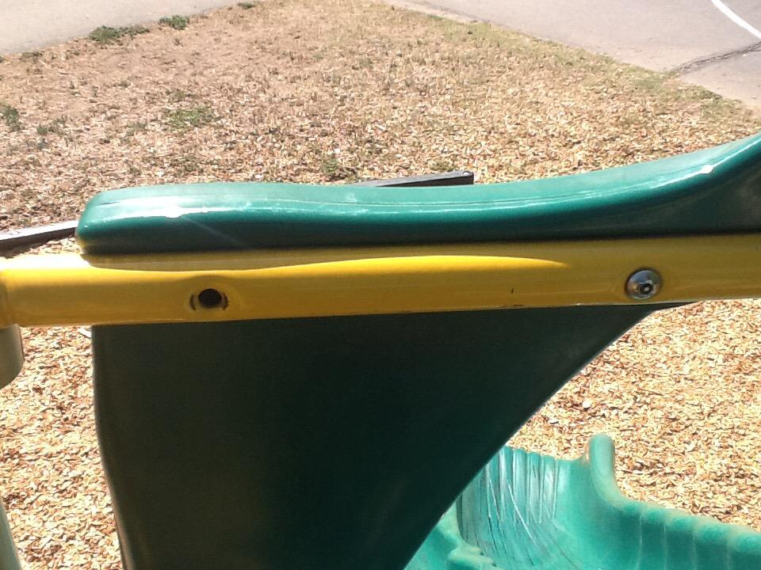

Slide 19
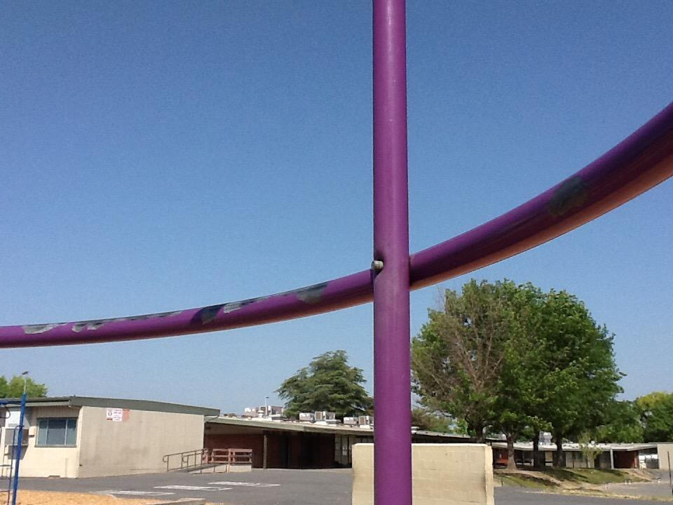
Protruding bolts can create entanglement hazards and cause potential injury

Slide 20
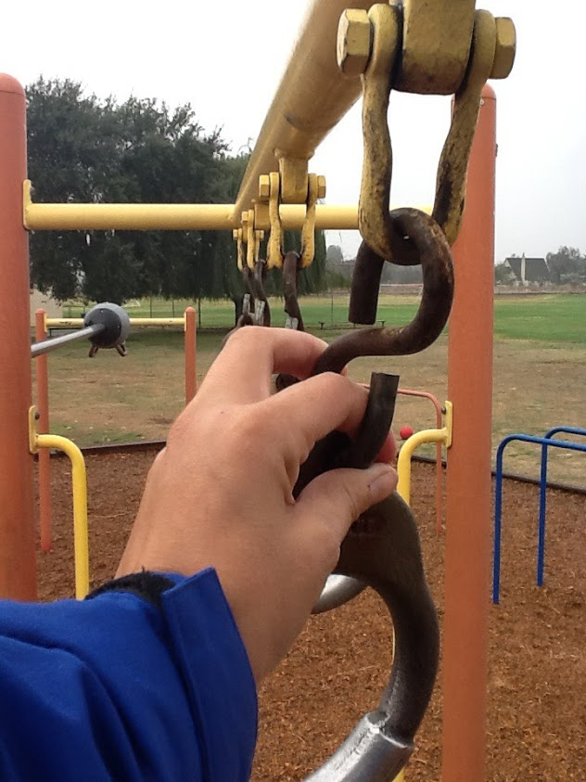
Open S-Hooks or other connections can cause equipment to become loose and disengaged as well as entangle clothing

Slide 21
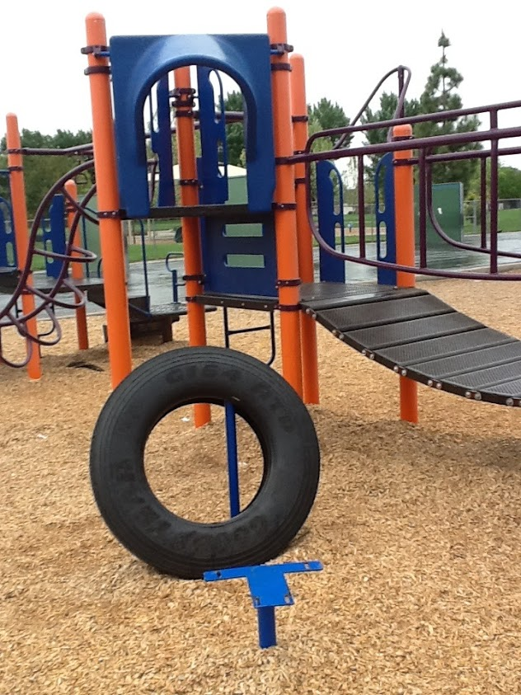
Missing equipment creates additional hazards. Block openings and close off all hazardous areas of the playground until repair or replacement is complete.

Slide 22
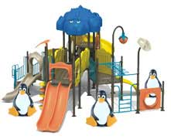
Contact the district for…
Major damage
Replacement of components
Changes to equipment
Planned purchase of new equipment
ADA compliance

Slide 23
Playground Resources
Visit SIA’s YouTube channel to view the video Conducting a Routine Playground Inspection
https://www.youtube.com/watch?v=uEyfYvits_s
SIA’s FREE playground warning labels:
https://www.sia-jpa.org/materials-order/

Slide 24
Thank you for keeping our kids safe!

